Slide 1
OUR FLASK APP
Site created for PGI laboratory

Slide 2
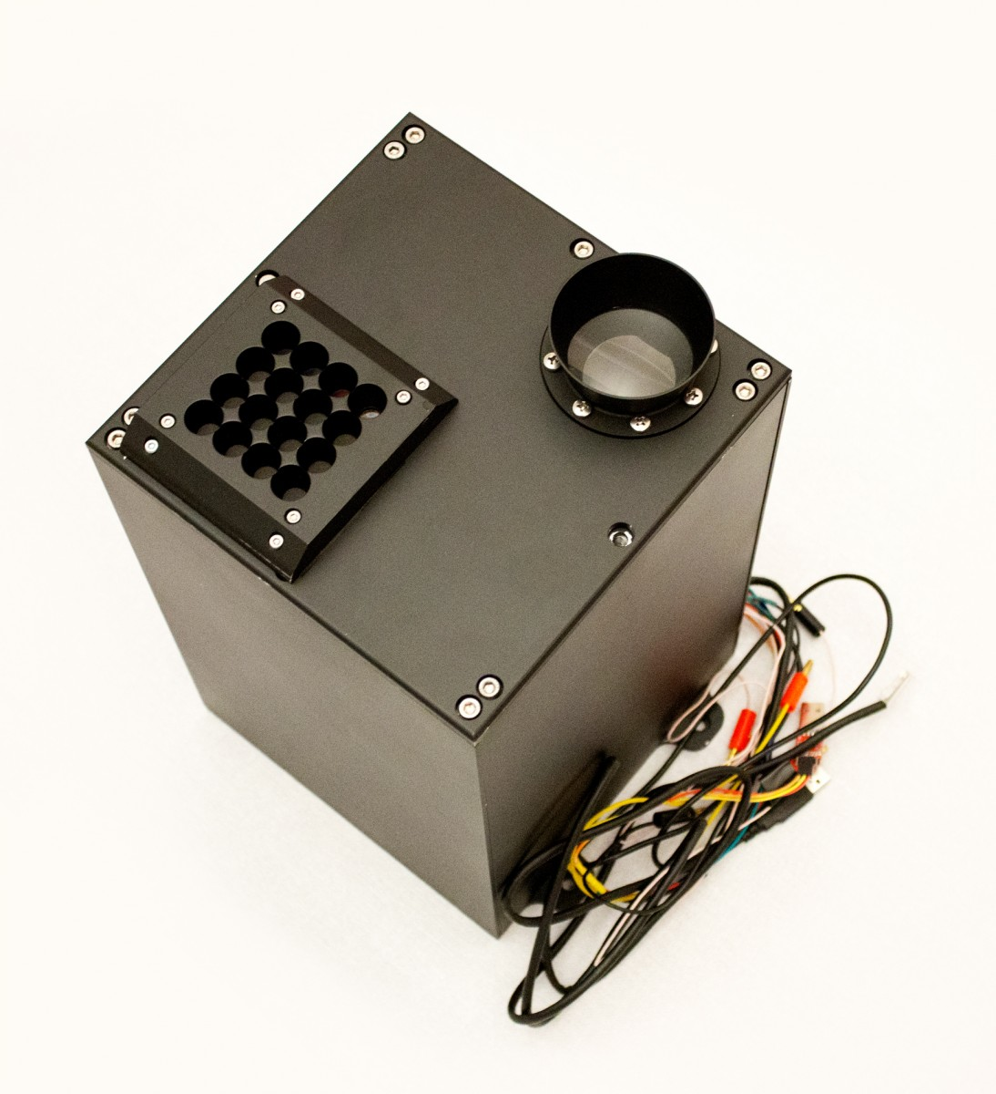

OUR Site displays data graphs, It gets them from the .mat files generated by “c” script
Telescope-spectrometer

Slide 3
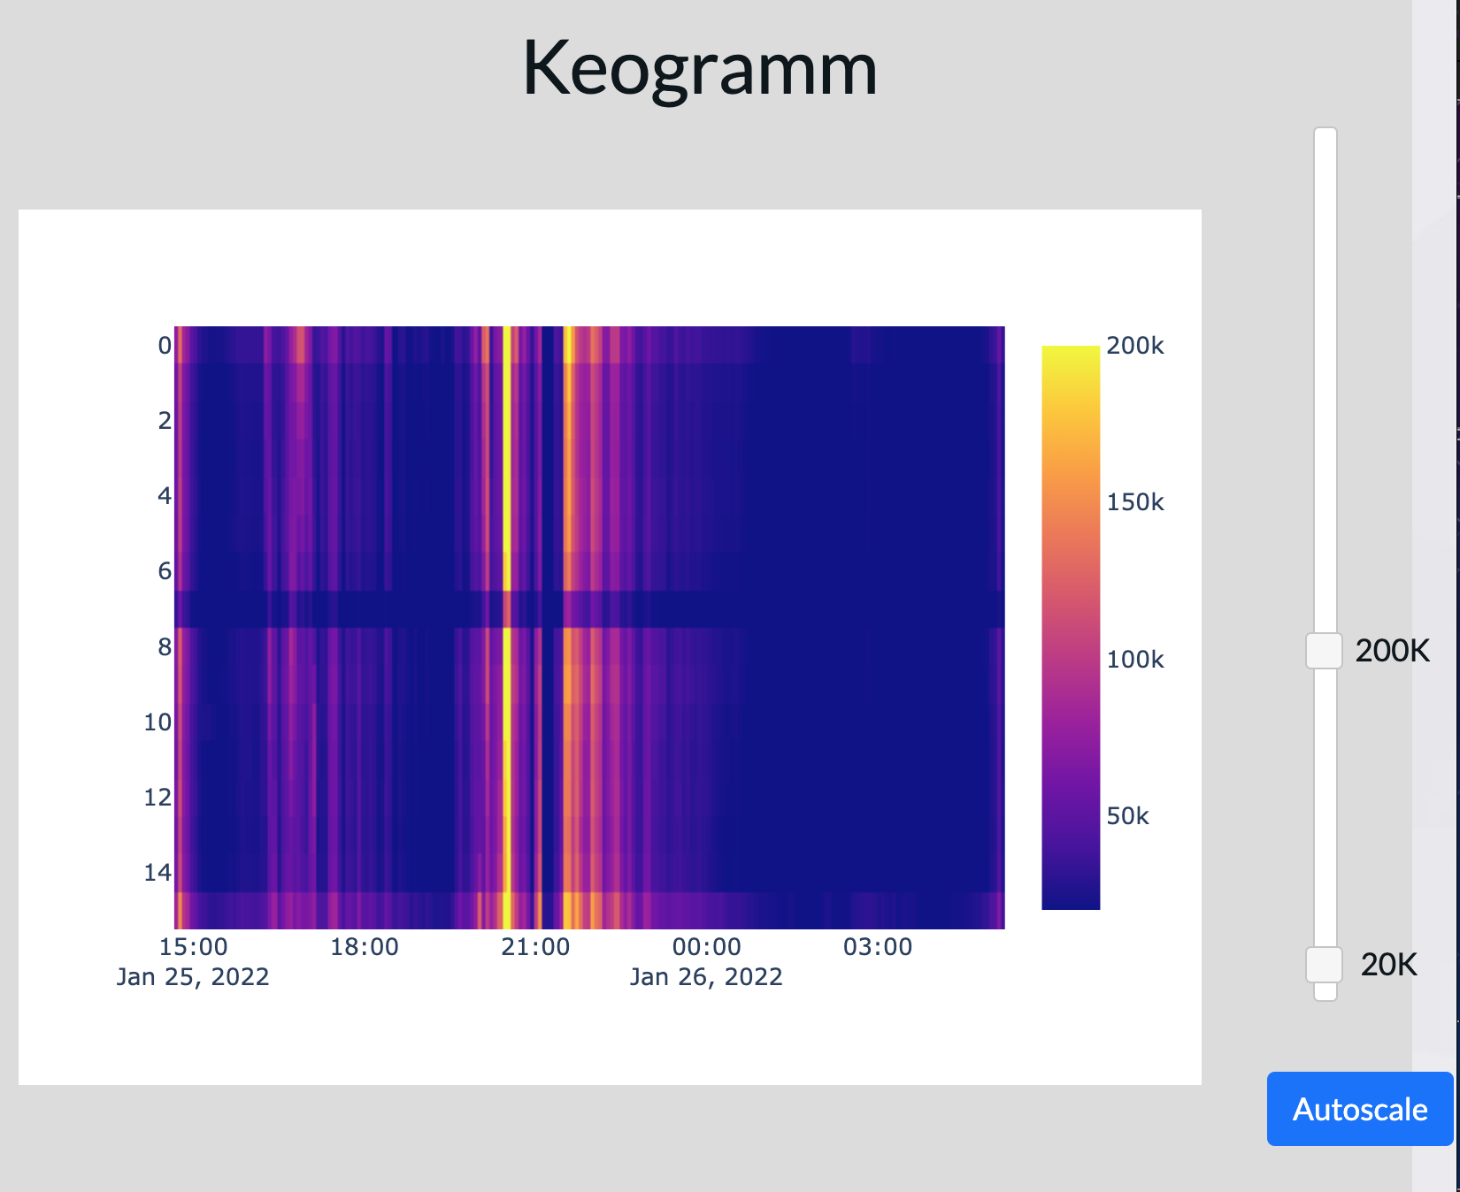
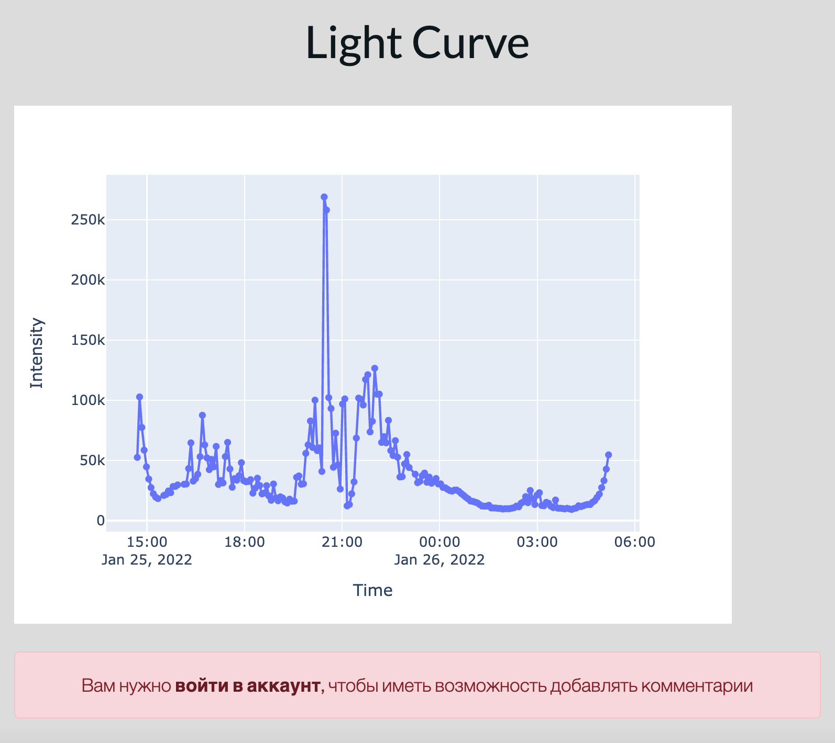
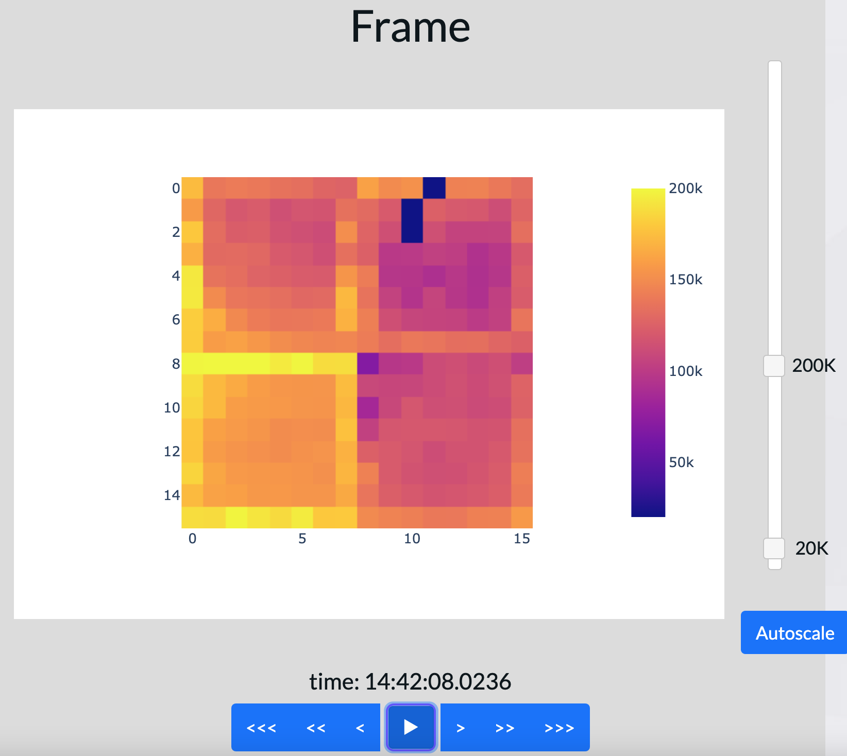
Many beautiful graphs with extra functions so
your work with them will be even better

Slide 4
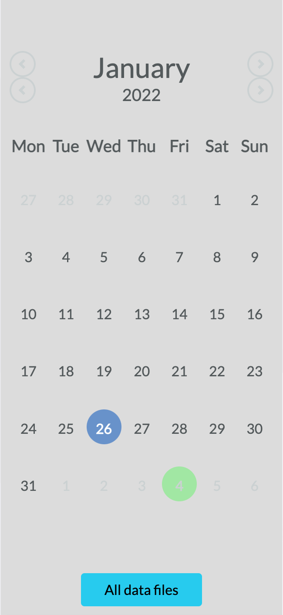
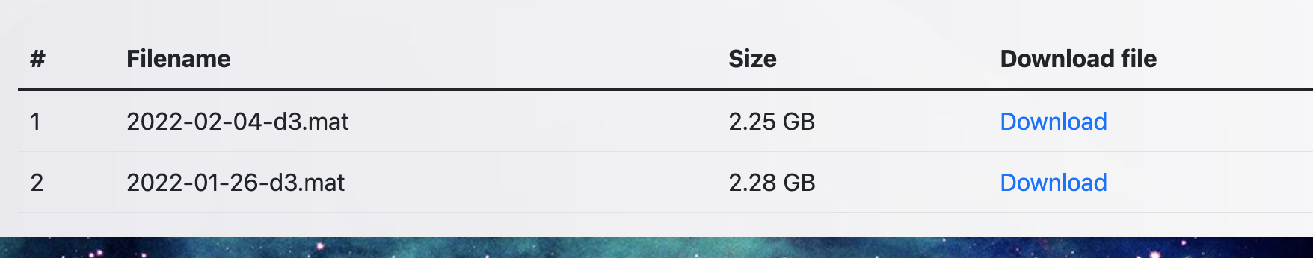
Beautiful flexible calendar
DESIGNED
SPECIALLY
FOR
YOUR
BETTER
EXPIRIENCE.
You can press any green date on the calendar and watch data you need.
You can also download data files “in raw form”

Slide 5
What else?....

Slide 6
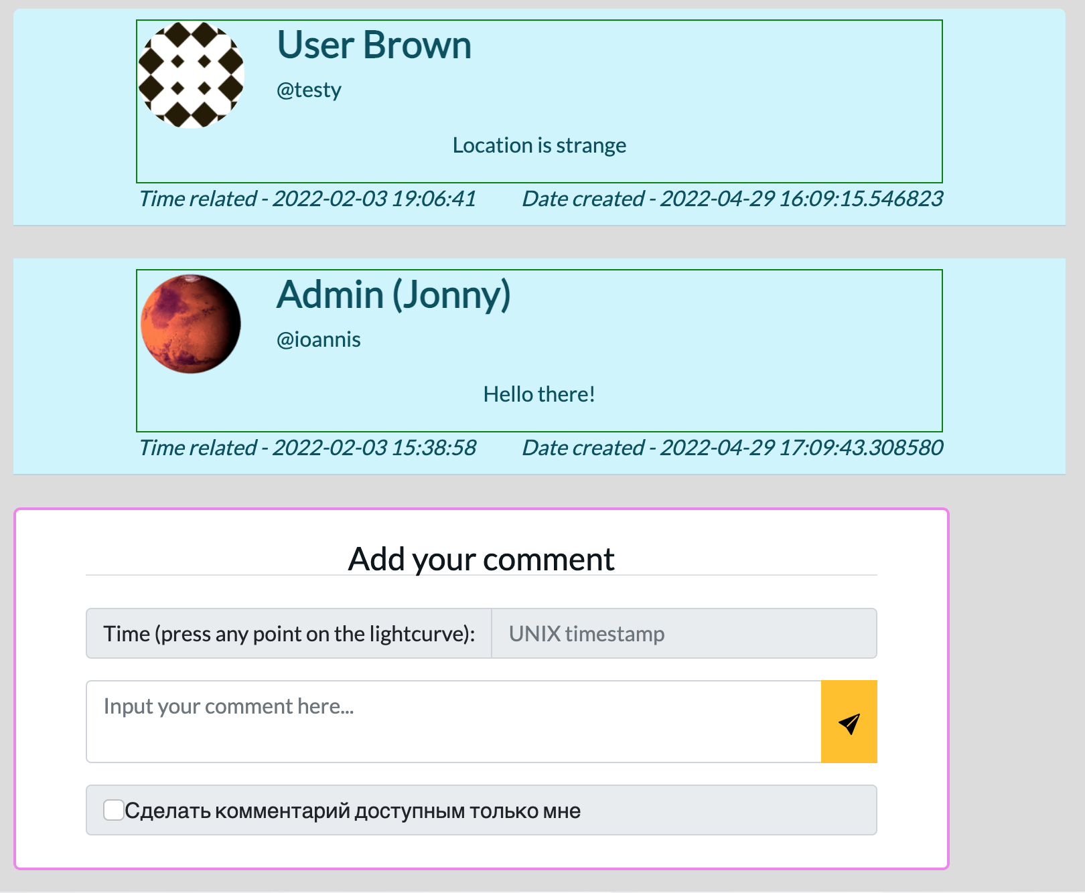
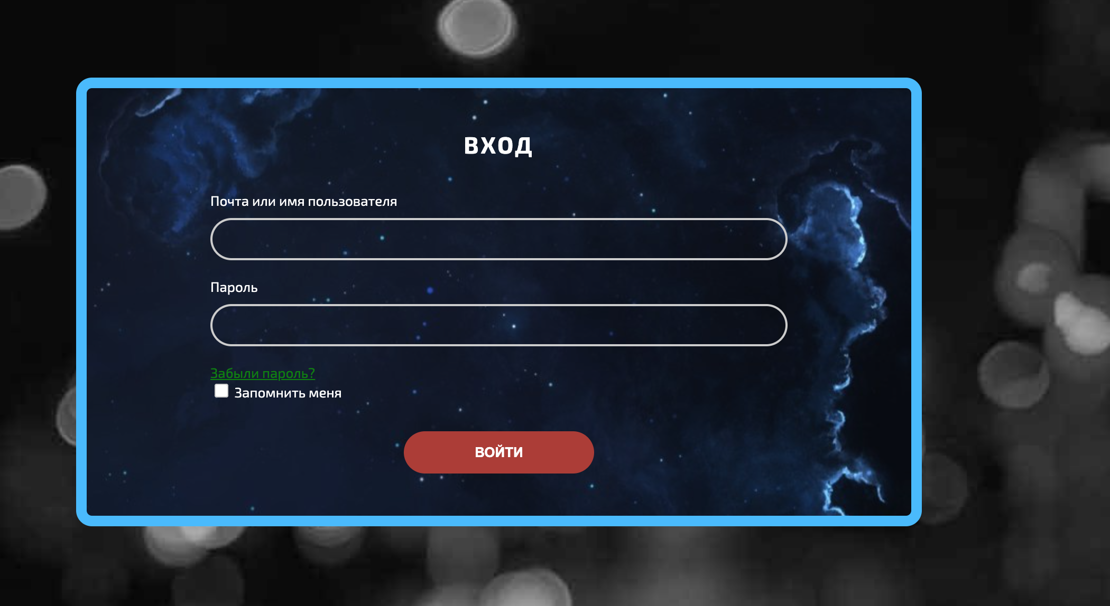
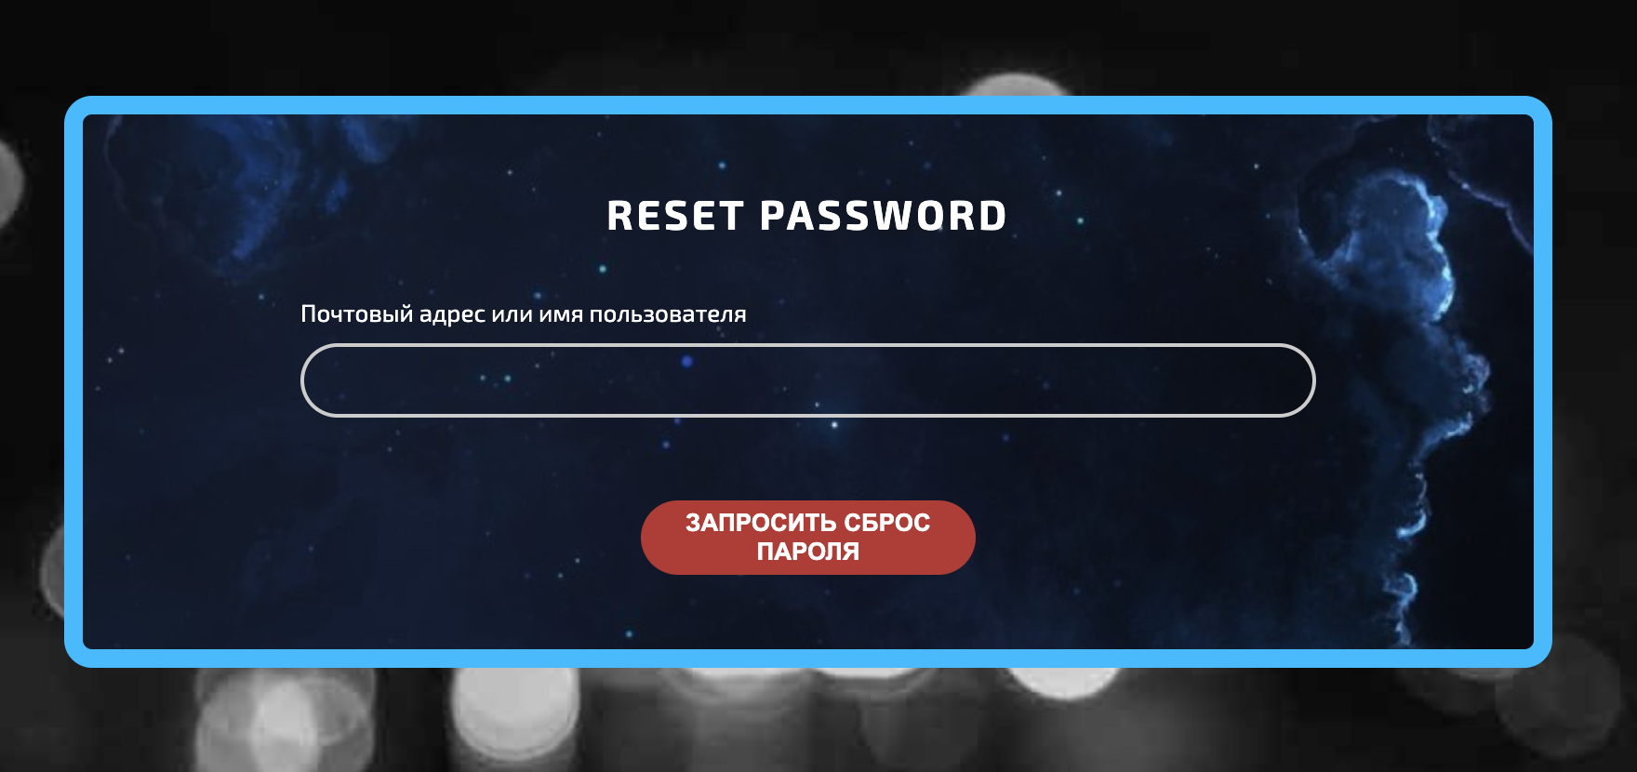
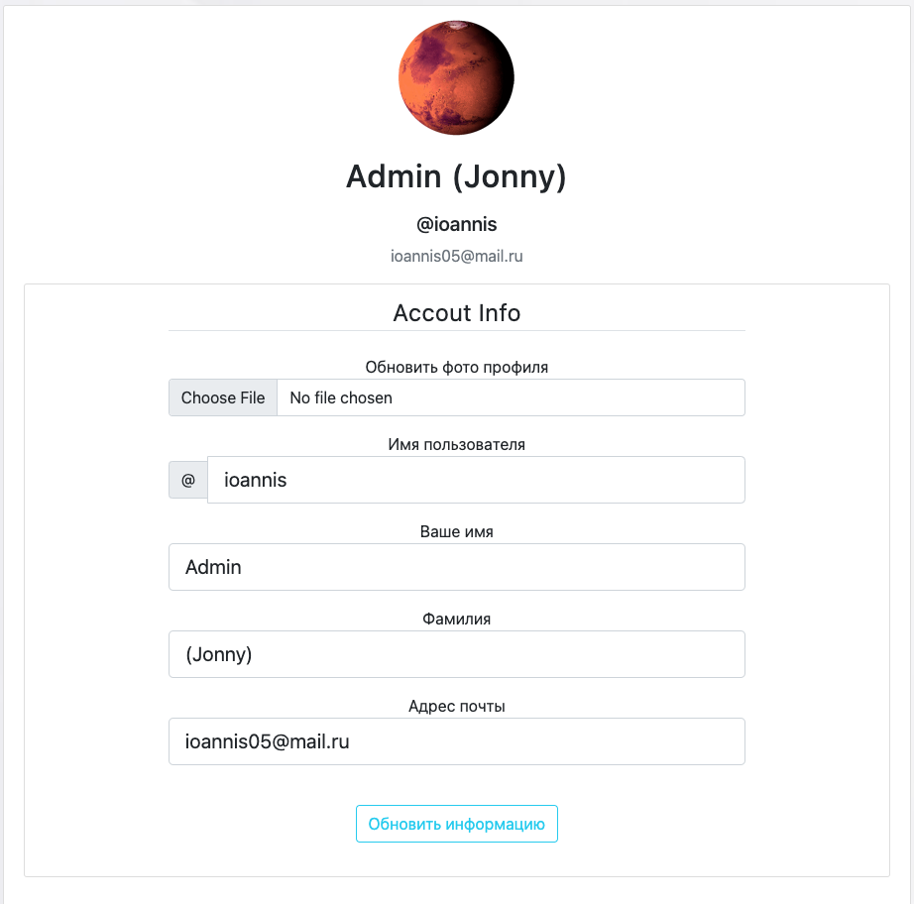
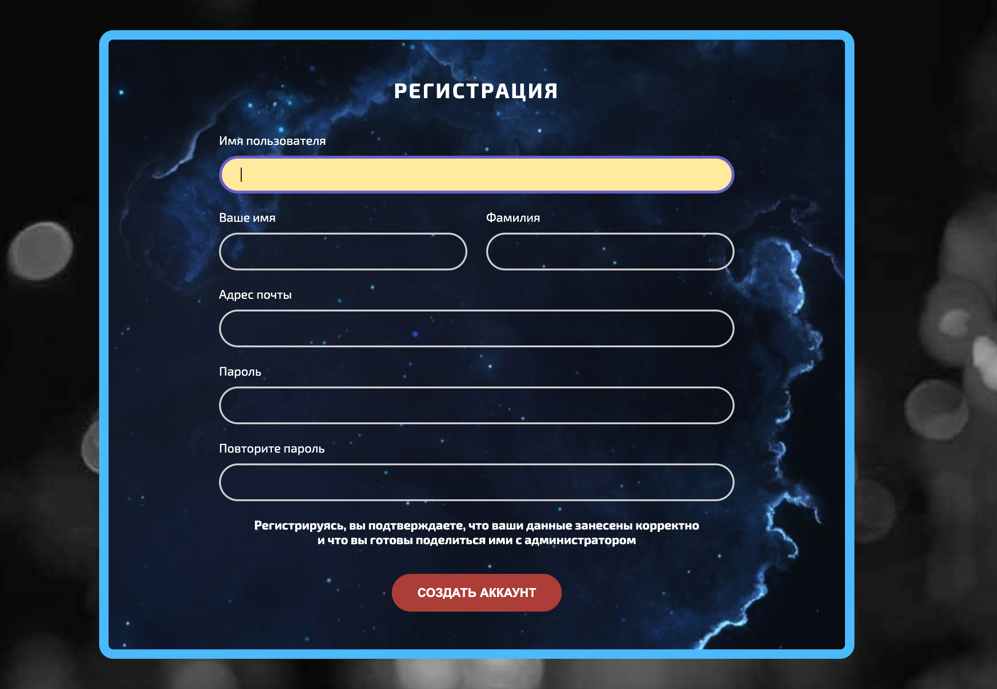
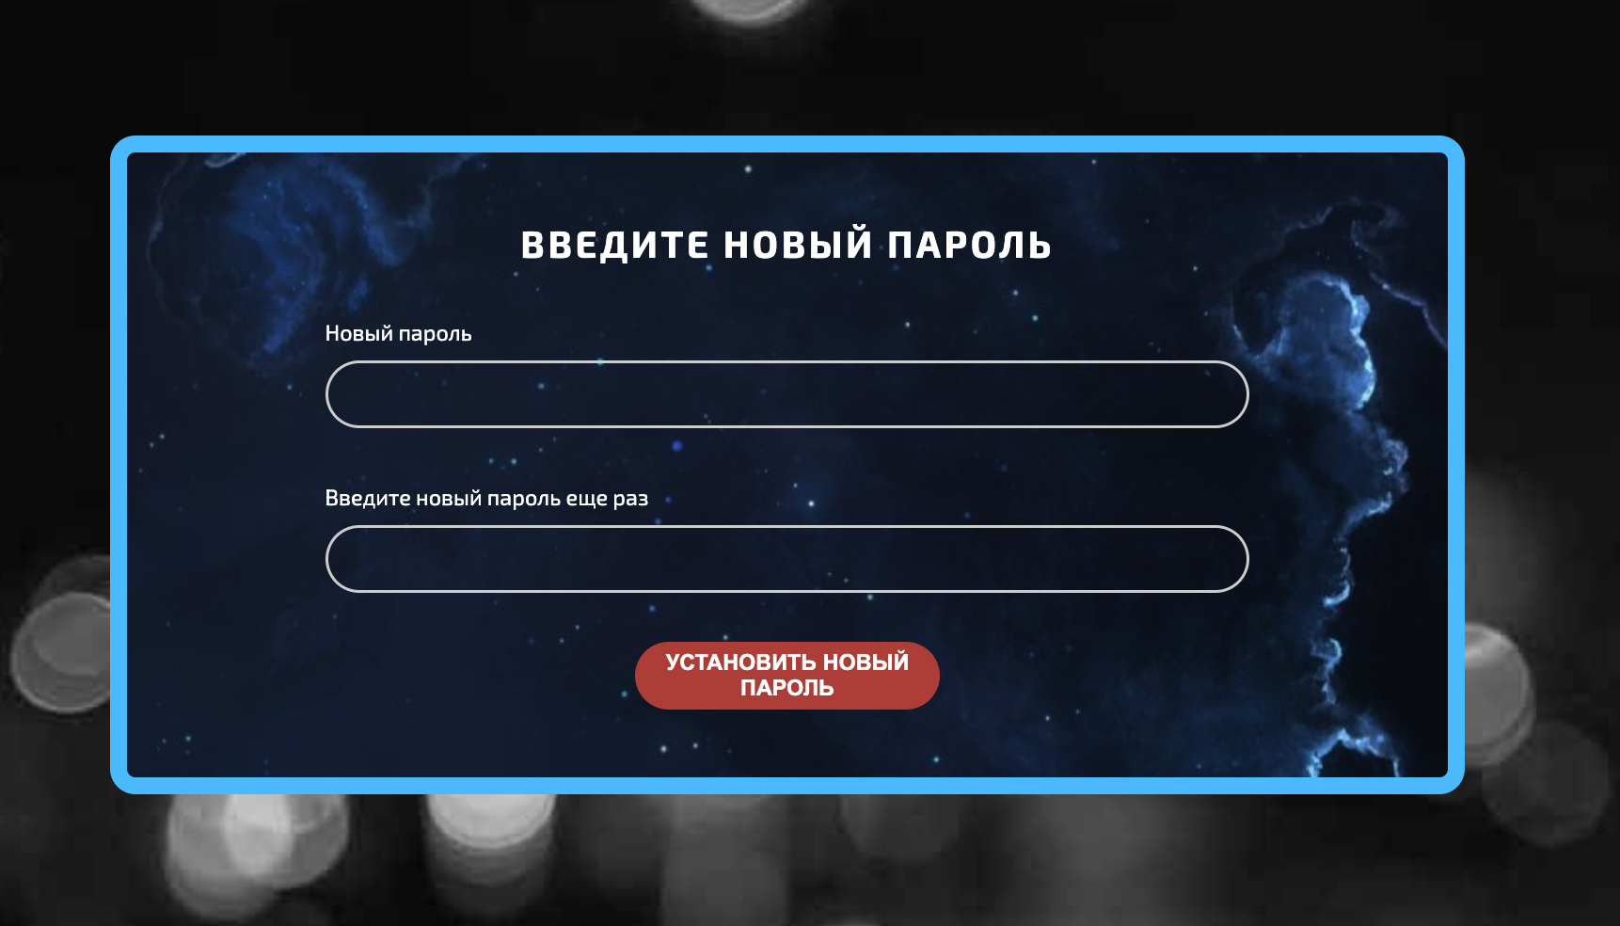
Amazing redesigned forms

Slide 7
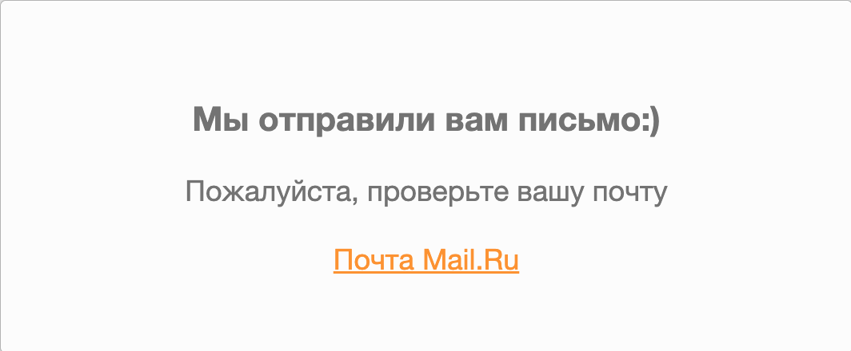
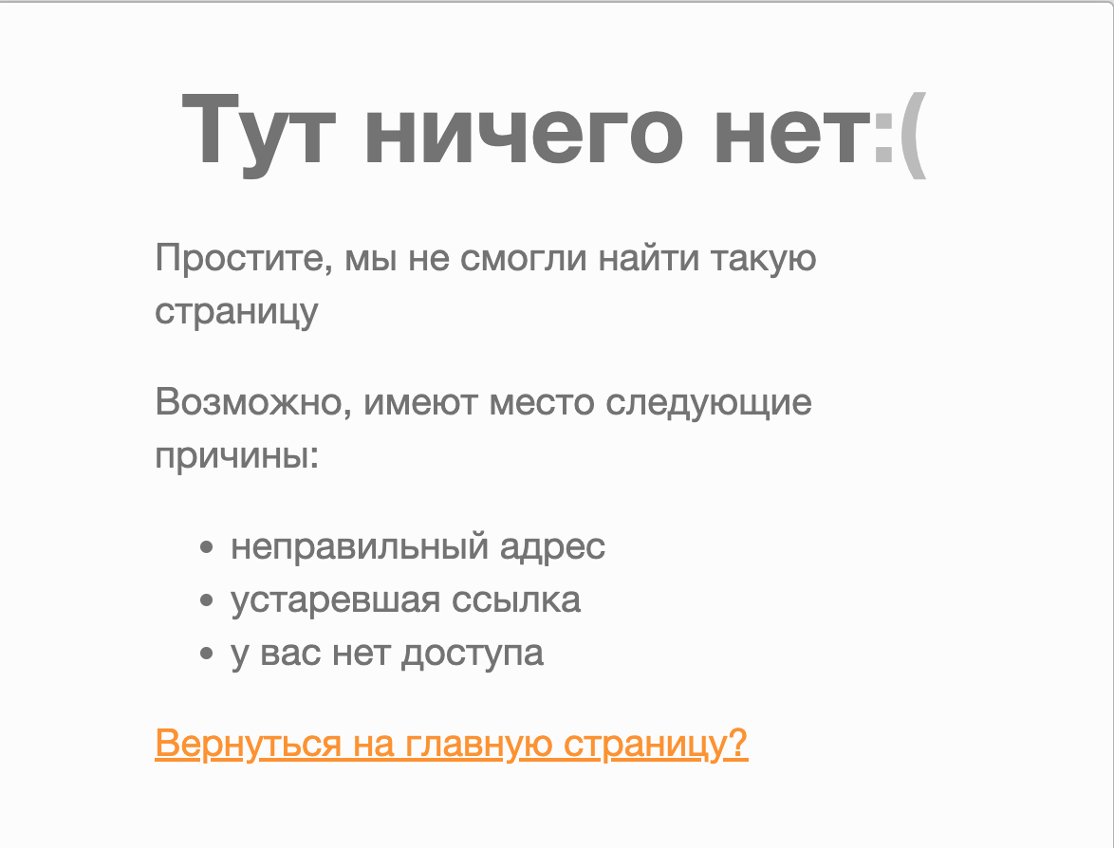
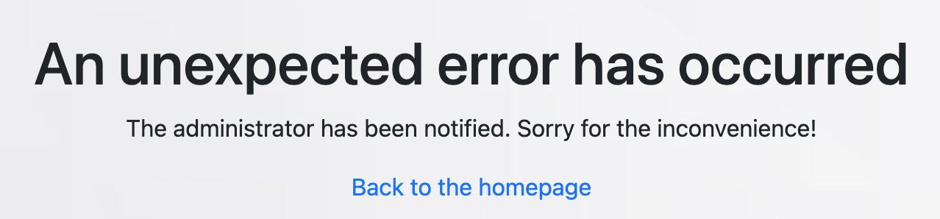
Our feature – when user
tries to reset password, it ==>
gives a link to his/her inbox
Informative error messages
404
500

Slide 8
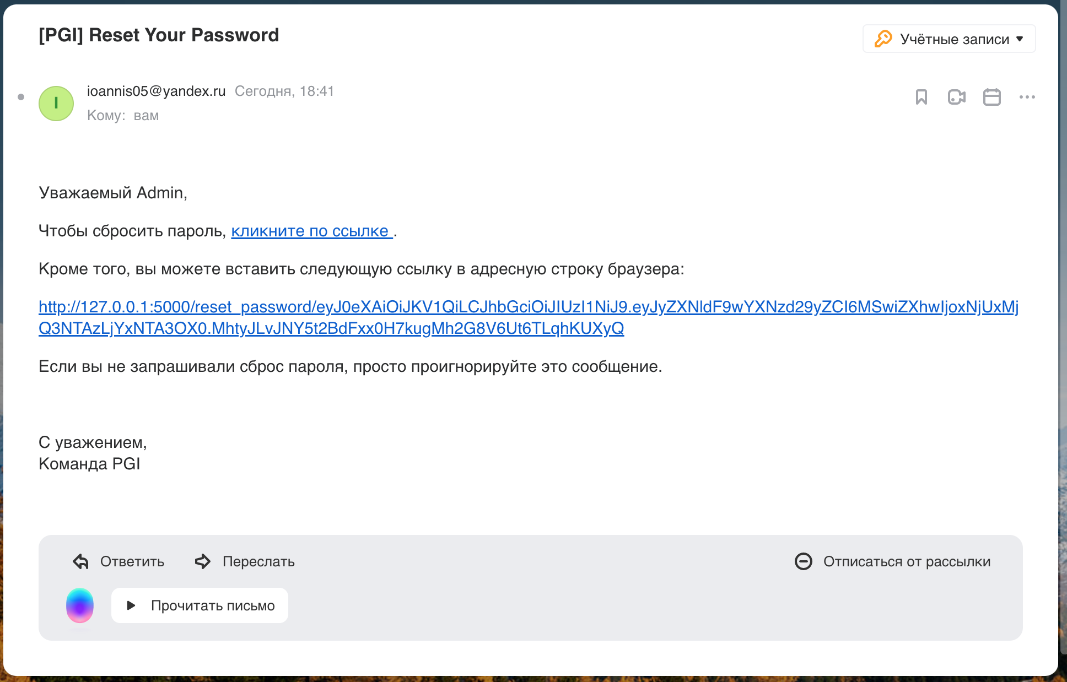
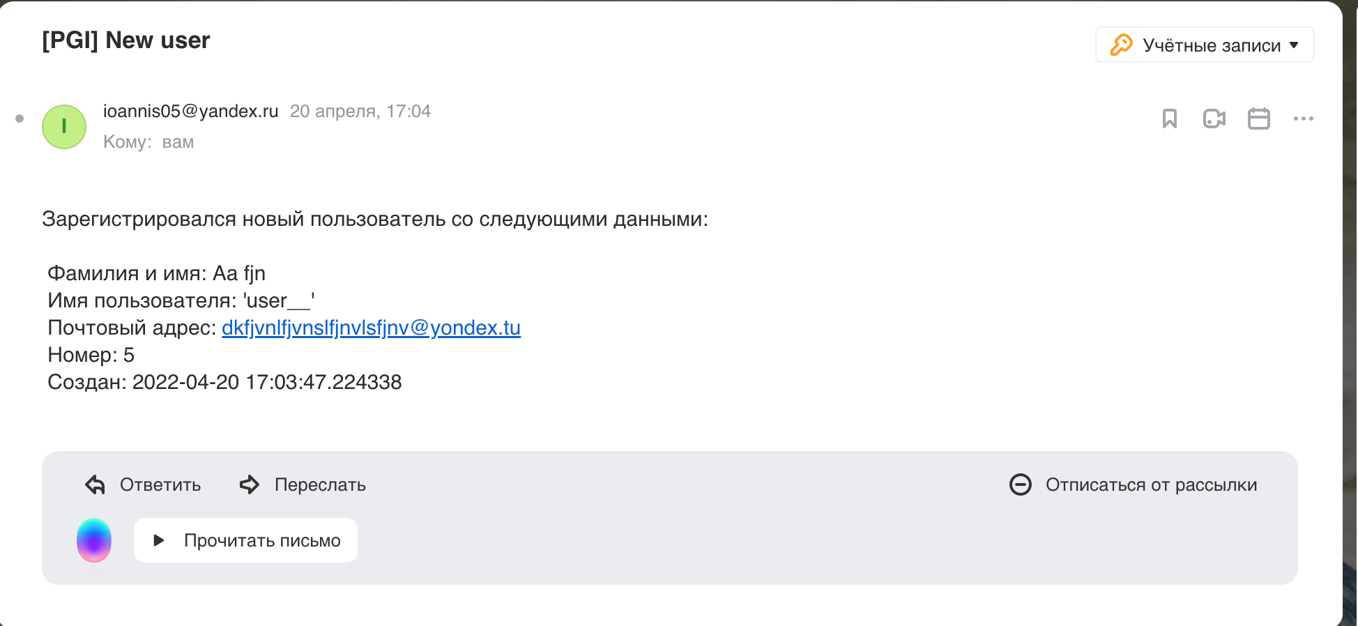
Our app sends e-mails to users

